Slide 1


Enhancing Data-Driven Medical Interventions To Combat Mpox in Underseved Communities
By:
Chukwu Blessing Ngozi
Sandra Oluchi Igboabuchukwu
Oluwatofunmi Adedayo Fak-Adeniyi
Zion Tech Hub

Slide 2
01.
Problem Statement
02.
Insights
03.
Recommendation
04.
Dashboard
05.
Conclusion
OUTLINE

Slide 3
PROBLEM STATEMENT
Mpox is re-surging as a pressing public heath challenge, particularly in underserved areas where weak infrastructure, poor surveillance, limited community health workers and limited access to vaccines hinder effective response.
These gaps highlight the urgent need for stronger data-driven decision-making to guide outbreak tracking, optimize vaccine deployment and improve case reporting in resource-limited settings.
Success means improved vaccination coverage, earlier outbreak detection, lower case fatality rates and stronger community resilience. The cost of inaction is far greater than the investment required today.
Zion Tech Hub

Slide 4
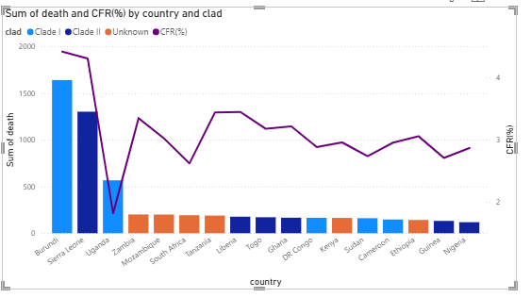
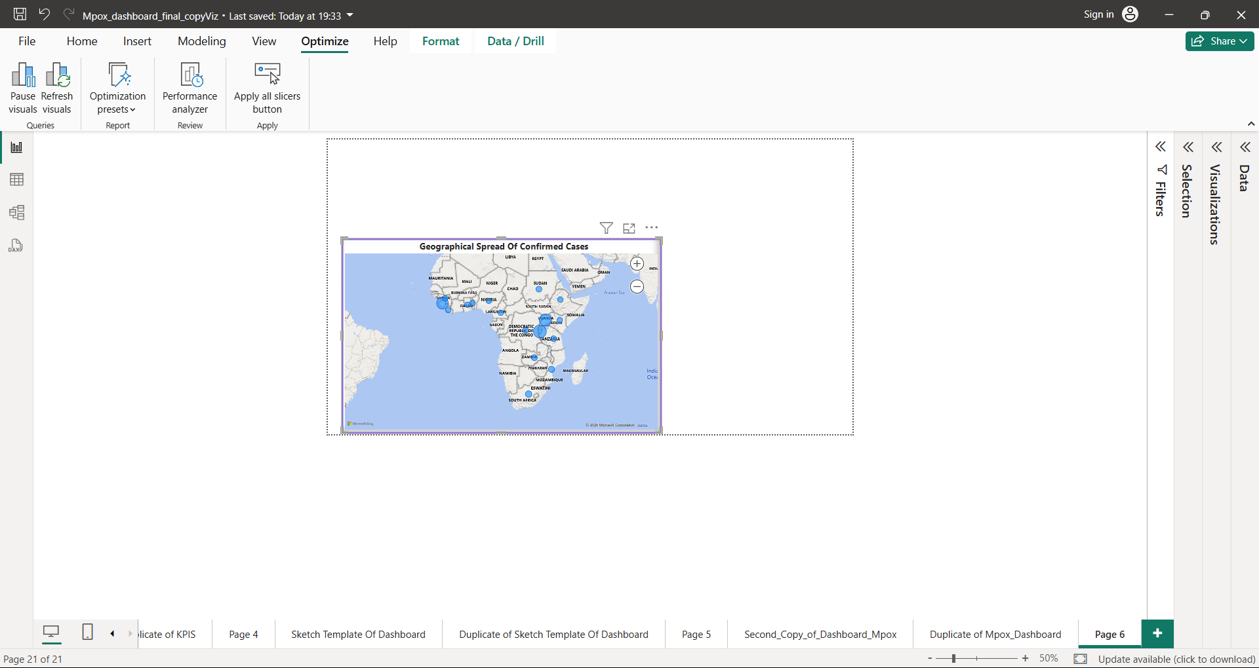
INSIGHTS
The map highlights the spread of Mpox across affected countries, with Burundi, Uganda, and Sierra Leone emerging as clear hotspots. Their disproportionately high case counts underscore the urgent need to redirect attention and resources to these countries before the outbreak escalates further.
Clade I dominates in Burundi and Uganda, making these countries the epicenters of the deadliest outbreaks.
Clade II is more prominent in Sierra Leone, contributing to cases but with lower severity compared to Clade I
Zion Tech Hub

Slide 5
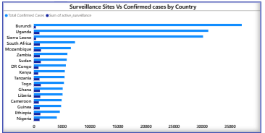
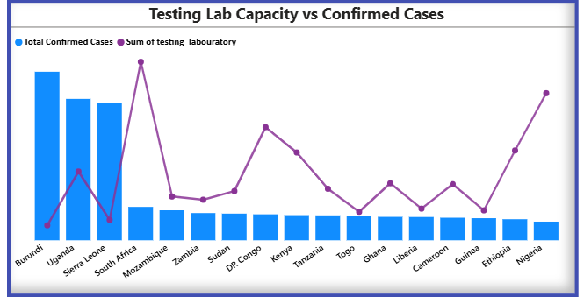
INSIGHTS CONT’D
The hotspot (Burundi, Uganda and Sierra Leone) countries show weak surveillance capacity relative to the outbreak burden.
This chart shows the testing laboratory capacity relative to the confirmed cases. Burundi, Uganda and Sierra Leone shows high confirmed cases and few laboratories. This could lead to outbreaks being under-diagnosed and under-reported.
Zion Tech Hub

Slide 6
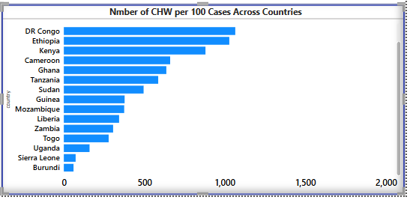
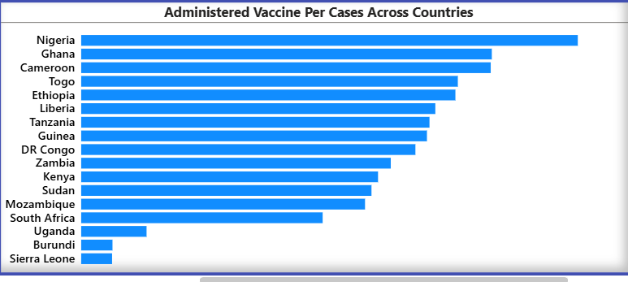
INSIGHTS CONT’D
This chart shows the available workforce to every 100 cases with the overburdened countries having low workforce capacity.
Ratio of administered vaccines to confirmed cases shows less vaccines are administered in hotspot countries compared to less burdened countries.
Zion Tech Hub

Slide 7
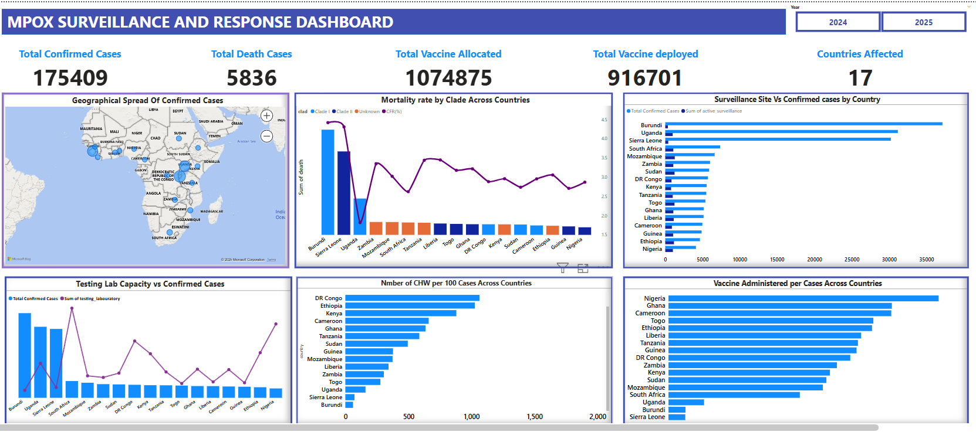
DASHBOARD
Zion Tech Hub

Slide 8

RECOMMENDATION
Prioritize High Burden Countries
and maintain the health systems of other countries.
RECOMMENDATION | HOW | IMPACT
Reallocation and urgent expansion of Surveillance sites | Scale up to 500-700sites. For instance Burundi has 357 sites to 37,140confirmed cases (104 cases per site) | ↑ Early case detection by 40%-96% estimate, faster reporting and stronger contact tracing
Strengthen diagnostic capacity | By Scaling up testing laboratories to 200- 500labs(185 -74 cases to 1 lab, using 37,104 confirmed cases). For instance, Burundi has 51 Labs to 37140 confirmed cases(728 cases to 1 lab) | ↓ Diagnostic delay and burden by 74-89% estimate. , faster isolation and treatment
Strengthen Frontline Response | By expanding the number of communityhealth workers | ↑ Vaccination administered and case reporting.

Slide 9
CONCLUSION
Policy-Level Takeaway
Urgent reallocation and expansion of surveillance sites, labs, and CHWs in hotspot countries will:
Boost early detection by 30–50%
Reduce diagnostic delays by 40–50%
Increase Vaccine uptake to combat outbreak and prevent cross border outbreaks to neigbouring countries surrounding this hot spot countries while strengthening and maintaining health systems among other affected countries.
Zion Tech Hub

